Slide 1

Software Project Management
Dr. Sumaira Nazir
Department of Software Engineering
National University of Modern Languages, Islamabad

Slide 2
Project Quality Management

Slide 3
Project Quality Management
Project quality management is a difficult knowledge area to define. The International Standardization Organization for (ISO) defines quality as “the totality of characteristics of an entity that bear on its ability to satisfy stated or implied needs” (ISO8042:1994) or “the degree to which a set of inherent characteristics fulfils requirements”

Slide 4
Project Quality Management
Conformance to requirements
Fitness for use
purpose of project quality management is to ensure that the project will satisfy the needs for which it was undertaken

Slide 5
Project Quality Management
Project quality management involves three main processes

Slide 6
Project Quality Management Processes
Planning quality management
Managing quality
Controlling quality

Slide 7
Project Quality Management Processes
Planning quality management
identifying which quality requirements and standards are relevant to the project and how to satisfy them

Slide 8
Project Quality Management Processes
Managing quality
involves translating the quality management plan into executable quality activities. These activities must adhere to the organization's quality policies. The main outputs of this process are quality reports, test and evaluation documents

Slide 9
Project Quality Management Processes
Controlling quality
involves monitoring specific project results to ensure that they are complete, correct, and meet customer expectations. This process is often associated with the technical tools and techniques of quality management, such as Pareto charts, quality control charts, and statistical sampling.

Slide 10
Tools And Techniques For Quality Control
Cause-and-effect diagrams trace complaints about quality problems back to the responsible production operations. In other words, they help you find the root cause of a problem. They are also known as fishbone or Ishikawa diagrams,

Slide 11
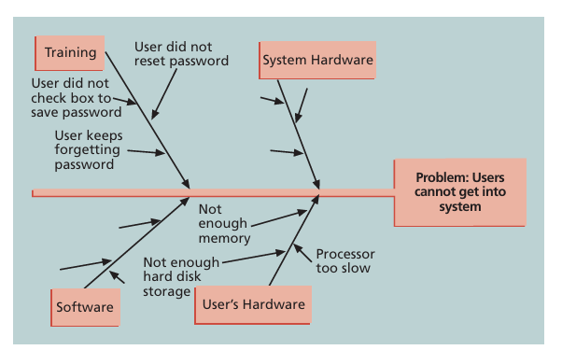
Cause-and-effect diagram

Slide 12
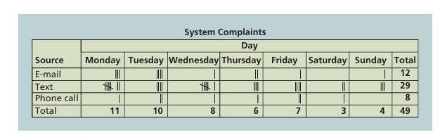
Sample Checksheet

Slide 13
Sample Checksheet
A checksheet is used to collect and analyze data.
It is sometimes called a tally sheet or checklist, depending on its format.
In example, most complaints arrive via text message, and there are more complaints on Monday and Tuesday than on other days of the week.
This information might be useful in improving the process for handling complaints

Slide 14
Testing
Testing
done during almost every phase of the systems development life cycle, not just before the organization ships or hands over a product to the customer
Unit
System
Integration
Acceptance

Slide 15
Cost of Quality five major cost categories related to quality
Prevention cost: The cost of planning and executing a project so that it is error-free or within an acceptable error range. Preventive actions such as training, detailed studies related to quality, and quality surveys of suppliers and subcontractors fall under this category

Slide 16
Cost of Quality five major cost categories related to quality
Cost of Quality
Appraisal cost: The cost of evaluating processes and their outputs to ensure that a project is error-free or within an acceptable error range. Activities such as inspection and testing of products, maintenance of inspection and test equipment, and processing and reporting inspection data all contribute to appraisal costs of quality.

Slide 17
Cost of Quality five major cost categories related to quality
Internal failure cost: A cost incurred to correct an identified defect before the customer receives the product. Items such as scrap and rework, charges related to late payment of bills, inventory costs that are a direct result of defects, costs of engineering changes related to correcting a design error, premature failure of products, and correcting documentation all contribute to internal failure cost.

Slide 18
Cost of Quality five major cost categories related to quality
External failure cost: A cost that relates to all errors not detected and corrected before delivery to the customer. Items such as warranty cost, field service personnel training cost, product liability suits, complaint handling, and future business losses are examples of external failure costs.

Slide 19
Cost of Quality five major cost categories related to quality
Measurement and test equipment costs: The capital cost of equipment used to perform prevention and appraisal activities.

